Slide 1
Predicting Taxi-Out Delay
Delivered By:
Brandon Pover
Shawn K
Safiuddin Mohammed
Trevor Moos
Vivek M

Slide 2
What is Taxi-Out Delay? Why is it important?
Taxi-out time is defined as the time between the actual pushback and wheels-off.
Prediction of taxi-out time is significant precondition for improving the operationality of the departure process at an airport, as well as reducing the long taxi-out time, congestion, and excessive emission of greenhouse gases.
About the Data Set
We downloaded the data set from Kaggle. This data was originally scraped under a Academic Paper under Review by IEEE transportation by the creators.
This file contains data about flights leaving from JFK airport between Nov 2019-Dec-2020.
Data Consists of 22 columns.
17 Quantitative Variables
4 Qualitative Variable
1 Predicted Variable Taxi-Out, measured in minutes.
28000 total number of records on file

Slide 3
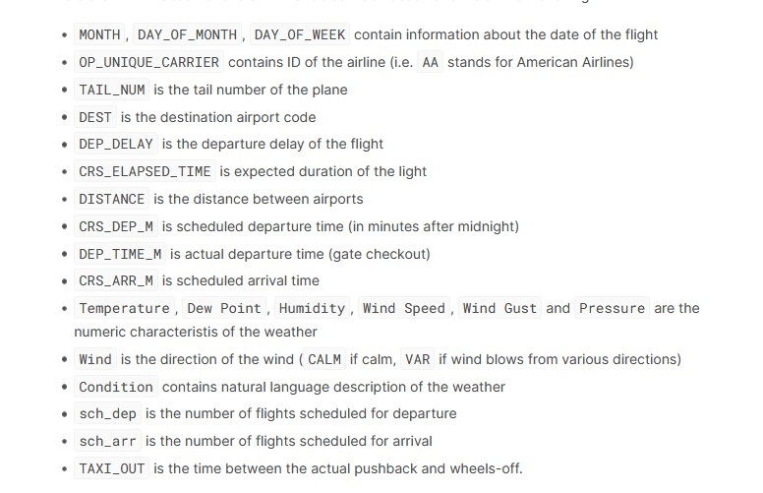
Each column explained, for reference:

Slide 4
Models Attempted
KNN (K nearest neighbors)
Boosting
Bagging
Random Forest
Linear Regression

Slide 5
k Nearest Neighbors
Brief Process followed
Train : Test ratio used is 75:25
Feature Selection
Cross-Validation done using K-fold to determine best k value in kNN
Get RMSE from the Test Data initially split.

Slide 6
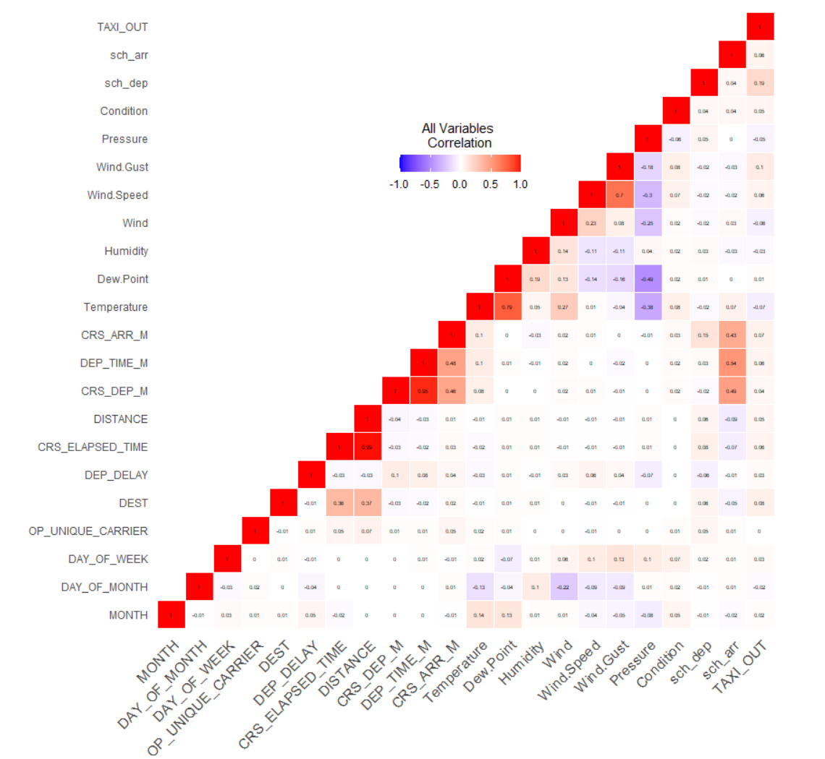
Correlation Matrix
There are 21 Features or Independent Data Variables.
If chosen by Brute force we would be looking at 2^21 combinations.
To rationally choose the features that are to be used in the KNN model, we use the correlation between each variable.

Slide 7
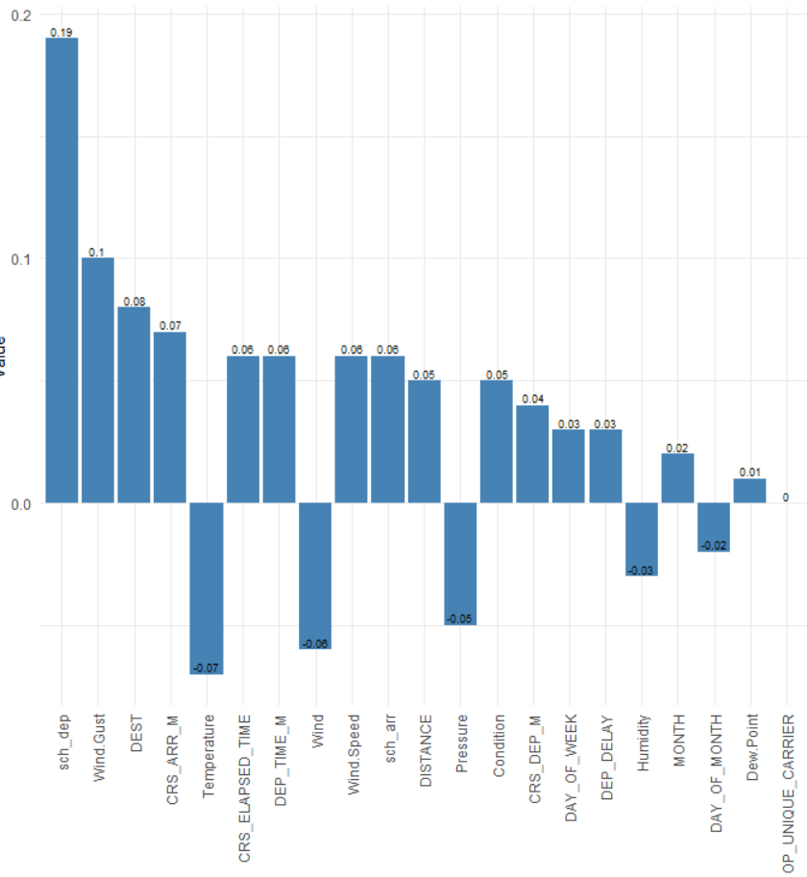
Correlation of Features Vs Taxi-Out Delay
Description | Feature Combination
Top 1 Correlated Variable | sch_dep
Top 2 Correlated Variables | sch_dep , Wind_Gust
…..
Top 21 Correlated Variables | All Factors

Slide 8

Label Encoding and Scaling
There are 5 Categorical Variables. To include these variables in the model and allow calculation of Euclidean distance, We perform Label encoding on these Values.
Finally we normalize each column in the dataframe to remove disparity due to units.

Slide 9
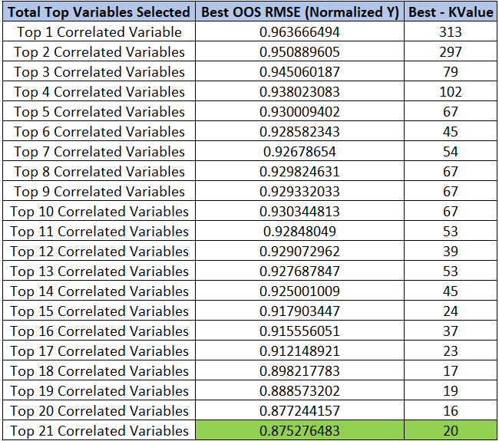
Tuning k - Done for each shortlisted Feature Combination
We perform K-Fold cross Validation with a 10 Folds. Aim is to get the best k values that shows the least RMSE.

Slide 10
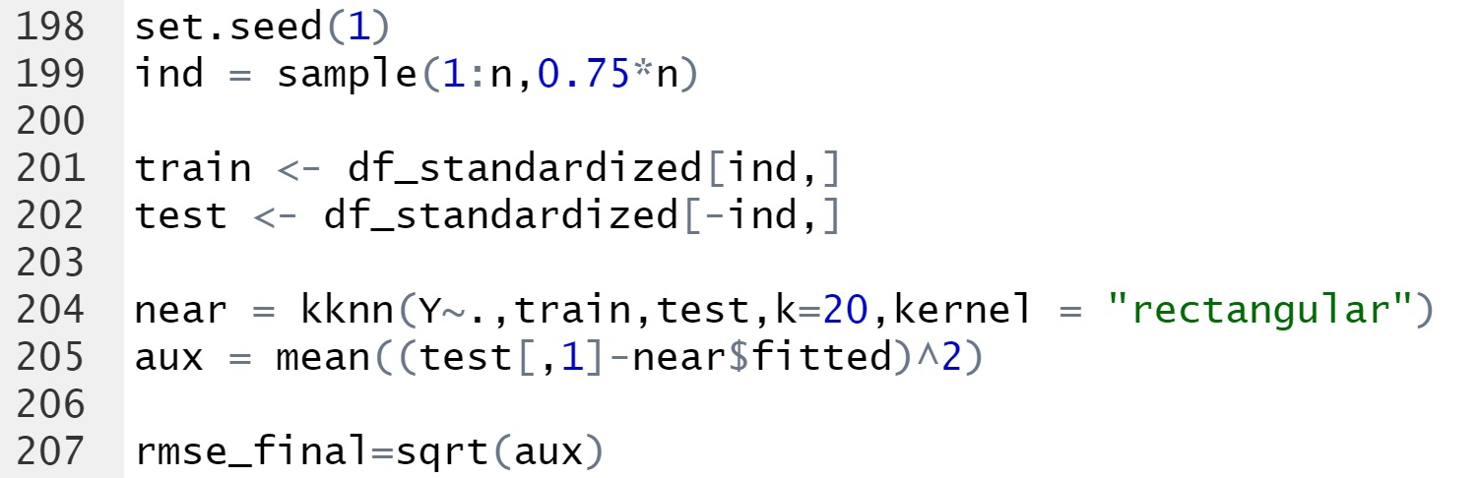
Final RMSE from KNN.
Final RMSE Value - 6.2441

Slide 11
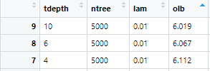
Boosting
Three different tuning parameters tested using a train, val, test split (50/25/25)
Tree depth = 4, 6, 10
Number of trees = 500, 1000, 5000
Lambda (crush) = 0.01, 0.1, 0.2
Best combination of parameters was

Slide 12
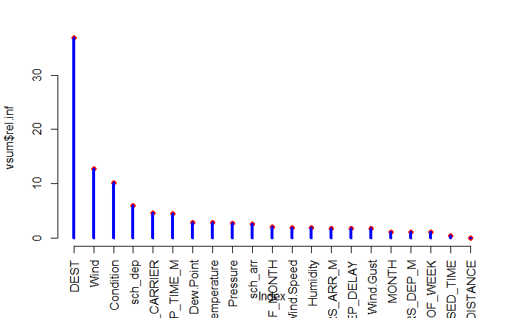
Boosting Results
Destination is the most important variable according to the boosting model, followed by wind.
OOB RMSE was found to be 5.89 on the test set with best parameters.
(10, 5000, 0.01)

Slide 13
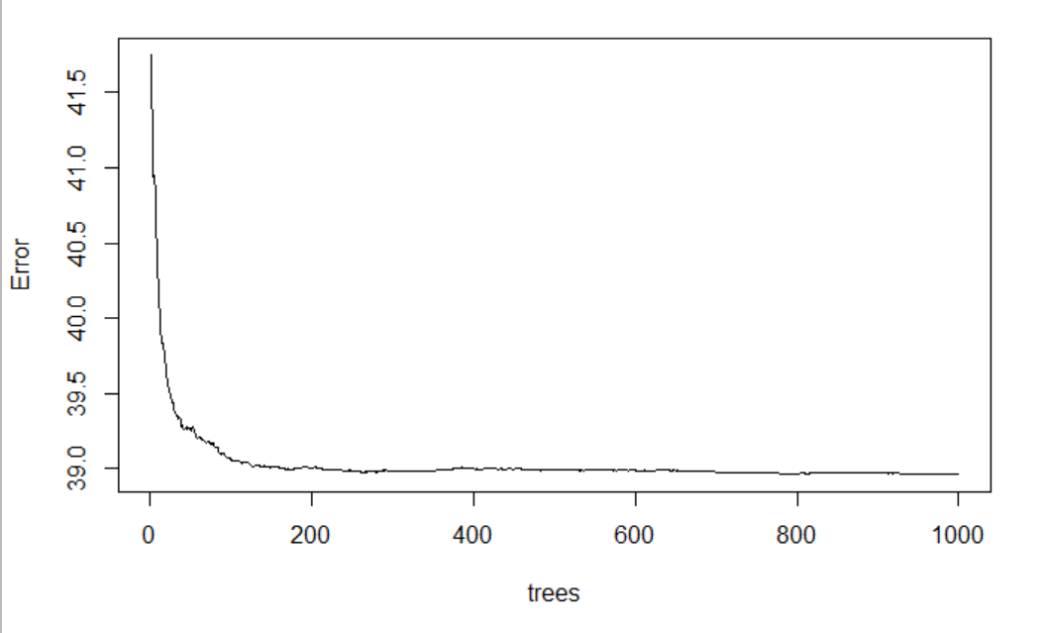
Bagging - Trees vs. Error
Minimal difference after 100 trees
Train: 75%
Test: 25%
Notes:
Before beginning a bagging model, I had to remove the variable Tail number and as the random forest function in R can only handle factors that have less than or equal to 53 levels.
Then the remaining data was split between a train and test set at 75% and 25% respectively
After doing that, I plotted the error versus the number of trees. As you can see there is minimal difference in the error after 100 trees which might be useful later when considering the computational costs

Slide 14
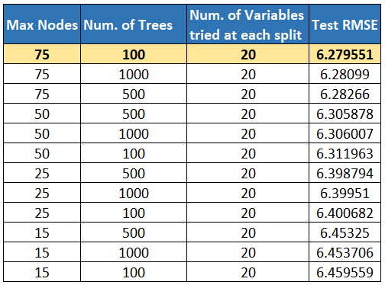
Bagging Model Testing
More complex = Better Test RMSE?
Consider Computational Costs
Notes:
We can see that minimal difference after 100 trees here and the effects of a different number of nodes.
The model with the lowest test RMSE is the bagging model with 75 nodes and 100 trees with a test RMSE of 6.27
Even though this model has the lowest test RMSE we have to consider computational costs and as you can see there is not much difference between 100 tree models that 75 and 50 max nodes so I would use the latter if computational costs were important from a business standpoint

Slide 15
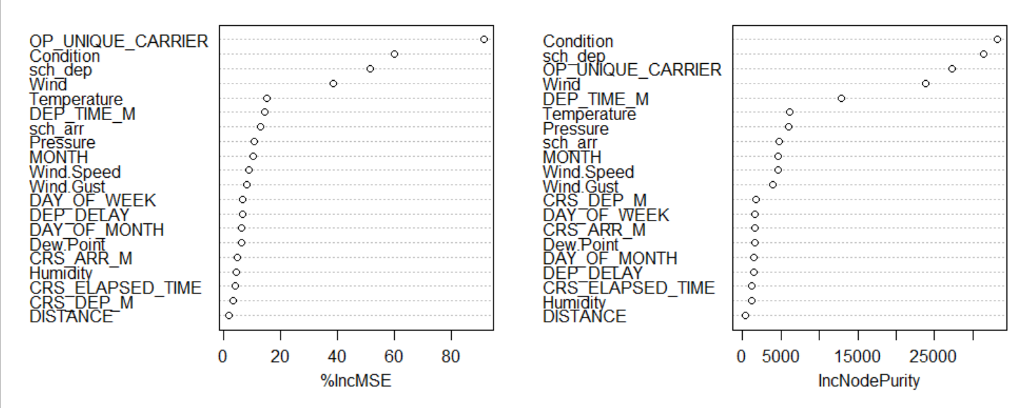
Bagging Variable Importance
Weather seems to have large impact on Taxi Out
Airlines carrier matters when predicting Taxi Out time
Notes:
Here we can see that there is a wide gap between the 4 or 5 most important variables and the rest.
You can see that weather, scheduled departure time, and airline carrier has a big impact on the taxi out time. If bagging allowed selection of predictors it might be of interest to remove variables such as distance and humidity.
Remember that variable importance for regression trees the variable is evaluated by the total amount that the residual sum of squares is decreased due to splits over a given predictor variable, averaged over all the trees
%IncMSE is the increase of the MSE when given variable is randomly permuted

Slide 16
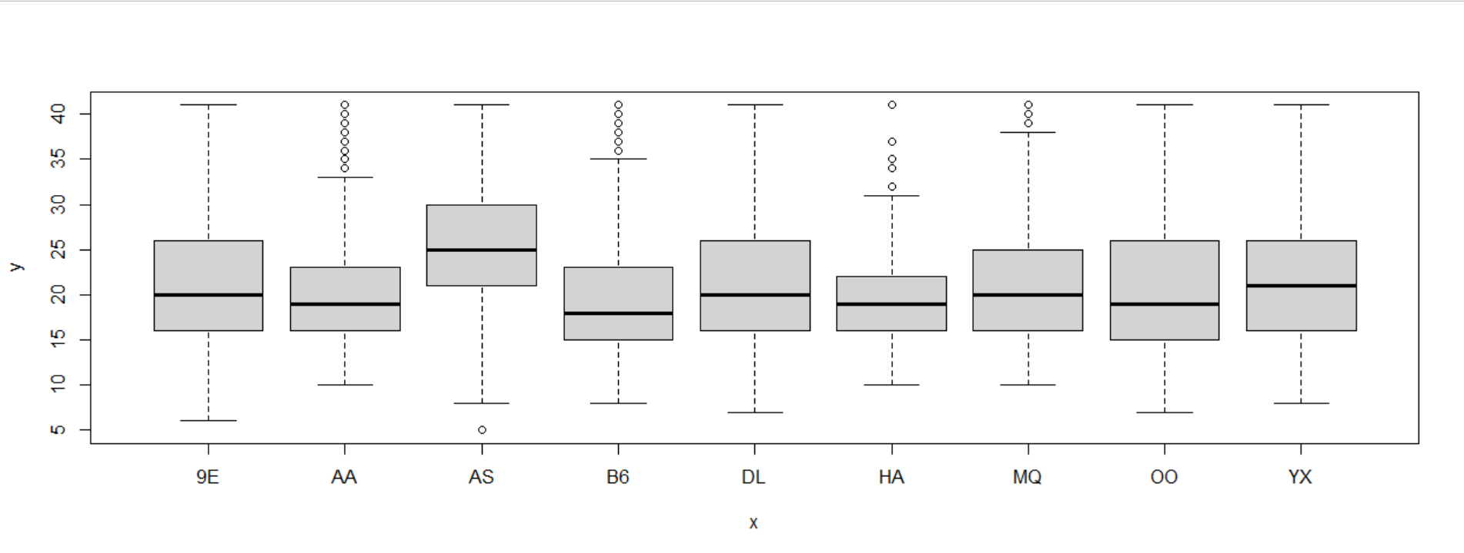
Airline Carrier Taxi Out Times
Notes:
9E = endeavor air
AA = american airlines
AS = Alaska Airlines
B6 = JetBlue Airways

Slide 17
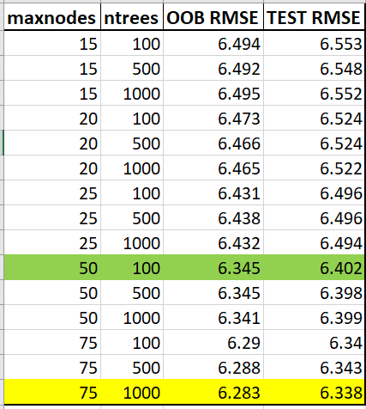
Random Forest Regressor
5-fold cross validation on 75/25 split
RF with 50 `maxnodes` and 100 `ntrees` produces similar results but it is less complex & more interpretable

Slide 18
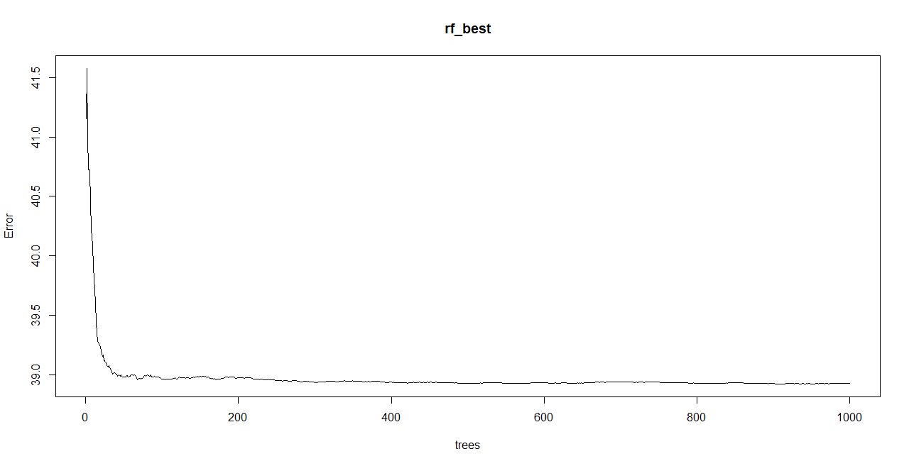
Maxnodes : 75
Number of trees : 1000
Train RMSE : 6.238
Test RMSE : 6.311

Slide 19
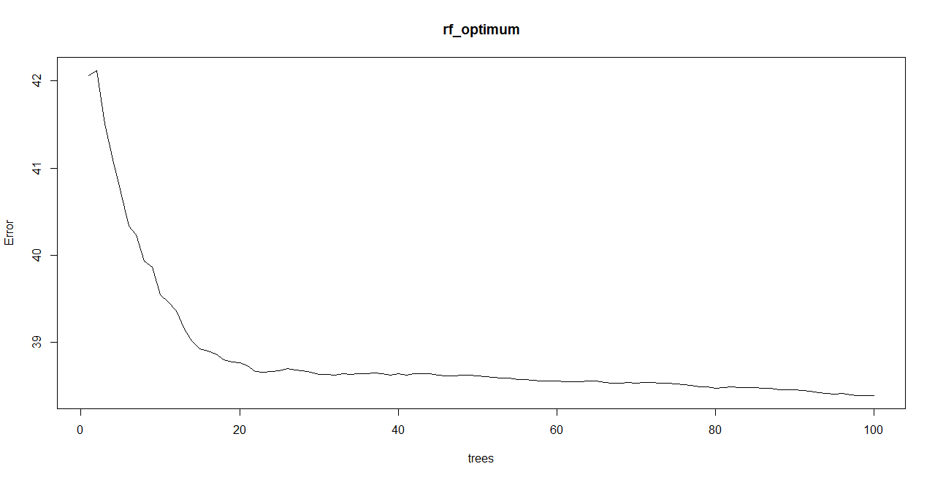
Maxnodes : 50
Number of trees : 100
Train RMSE : 6.196
Test RMSE : 6.263

Slide 20
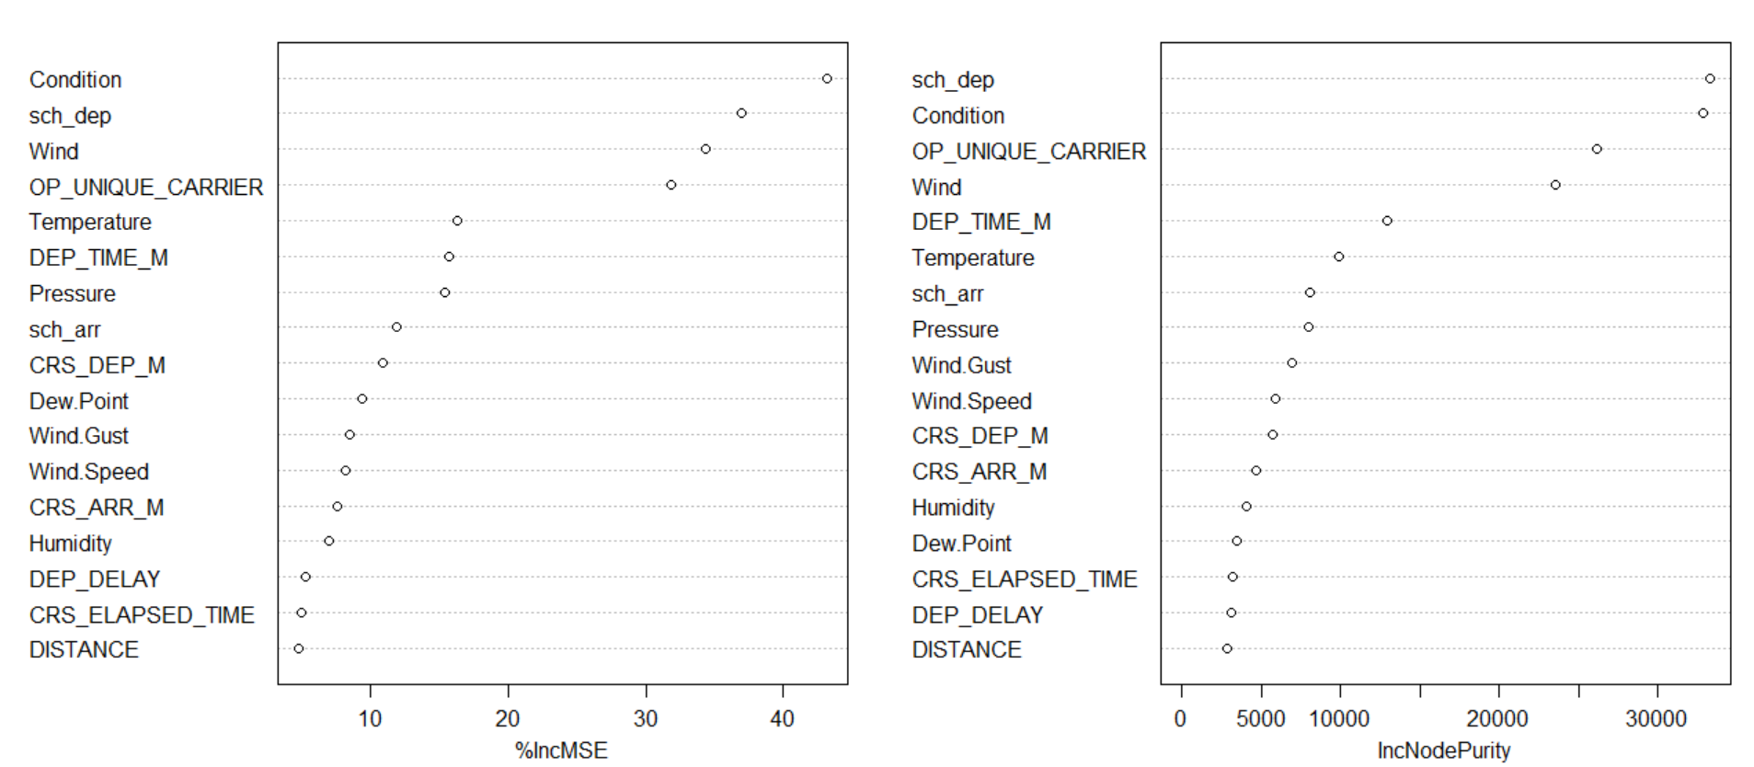

Slide 21
Multiple Linear Regression
Y = β₀ + β₁X₁ + β₂X₂ + · · · + βpXp + ϵ
Notes:
When we perform multiple linear regression, we usually are interested in answering a few important questions:
1. Is at least one of the predictors useful in predicting the response?
2. Do all the predictors help to explain Y, or is only a subset of the predictors useful?
3. How well does the model fit the data?
4. Given a set of predictor values, what response value should we predict, and how accurate is our prediction?

Slide 22
1. Is at least one of the predictors X₁, X₂,...,Xₚ useful in predicting the response? Yes, somewhat.
MONTH: Coef = 0.0254, F=9.871
DAY OF MONTH: Coef = -0.0188, F = 16.59
DAY OF WEEK: Coef = 0.098, F = 23.24
DEP_DELAY: Coef = 0.006, F = 35.11
CRS_ELAPSED_TIME: Coef = 0.004, F = 145.3
DISTANCE: Coef = 0.0005, F = 103.6
CRS_DEP_M: Coef = 0.001, F = 58.12
DEP_TIME_M: Coef = 0.001, F = 96.92
CRS_ARR_M: Coef = 0.001, F = 147.6
Temperature: Coef = -0.058, F = 132.2
Humidity: Coef = -0.008, F = 20.75
Wind.Speed: Coef = 0.068, F = 113.1
Wind.Gust: Coef = 0.055, F = 266
*Pressure: Coeff = -1.372, F = 101.7
*sch_dep: Coeff = 0.137, F = 1080
sch_arr: Coef = 0.053, F = 119.6
*Pressure and sch_dep are the most significant
Notes:
For question 1, I began by looking for meaningful predictors. A simple regression was executed for every quantitative column and the coefficients and F-scores were noted.
The variables for air Pressure and scheduled_departures came back with the coefficients that were furthest away from zero. Also, the F-score for scheduled_departures was much higher than 1 and any other variable for that matter, indicating a substantial relationship with TAXI_OUT.

Slide 23
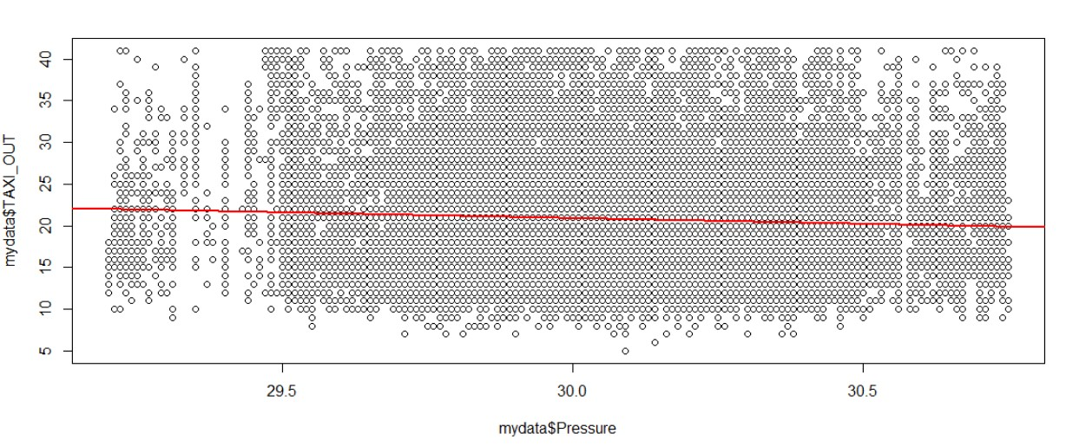
Notes:
Here is a a simple plot showing that as Pressure increases, TAXI_OUT time decreases slightly

Slide 24
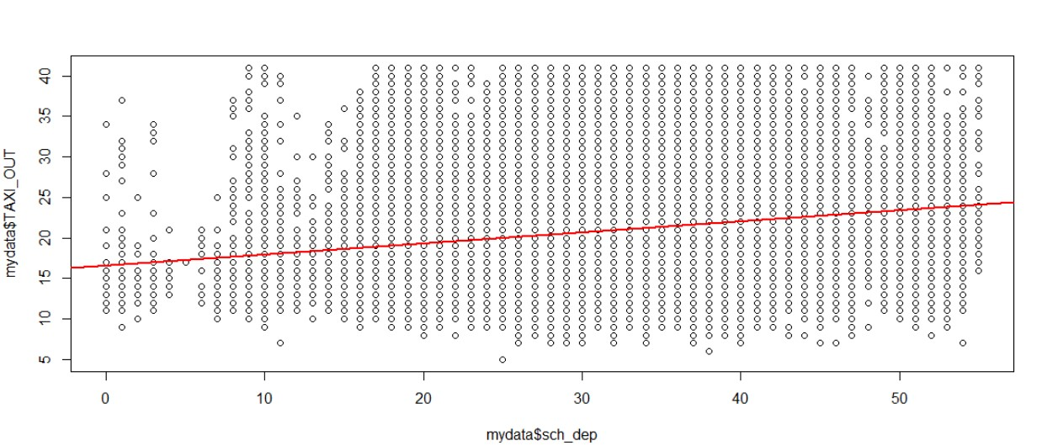
Notes:
And here is a simple plot showing that as scheduled_departures increases, TAXI_OUT time increases

Slide 25
2. Do all the predictors help to explain Y, or is only a subset of the predictors useful? Only a subset
Using mixed selection, variables that made the closest predictions of Y were found. Those variables are sch_dep and sch_arr.
3. How well does the model fit the data? Not very well
With multiple linear regression we look at adjusted R-squared to check for model fit. Using sch_dep, sch_arr, and Pressure the adjusted R-squared score was 0.044, which was the 2nd highest score. The highest adjusted R-squared score of 0.072 was attained by using every quantitative variable, yet that model did not give the most accurate predictions.
Notes:
For question 2, there were variables that seemed important in predicting TAXI_OUT before any tests were done. It makes sense that the more crowded the airfield is (i.e., more scheduled departures), the longer it will take to go from the gate to lift-off. Only a small number of the variables seemed to be useful when attempting to predict TAXI_OUT.
For question 3, typically every time a variable is added to the multiple regression model, the adjusted R-score goes up at least slightly, regardless of that variables effect. So, I was looking for a score that approached 0.072, with the fewest variables possible. Scheduled departures and scheduled arrivals got the closest, with a score of 0.044. The reason this approach does not work well is because even with every variable being considered, only 7.2% of the variance can be explained.

Slide 26
4. Given a set of predictor values, what response value should we predict, and how accurate is our prediction?
Y = 15.29 + 0.135sch_dep + 0.048sch_arr
The best prediction this model provides is still not very accurate. When using values from the first row - 9 for sch_dep and 17 for sch_arr, the model predicts 17.321. The actual value of TAXI_OUT in the first row is 14.
The Residual standard error is about 6.7
Notes:
For question 4, the equation that gives the best prediction is given here, though it’s still not very accurate.

Slide 27
Summary
For a long term airport strategy for tackling a taxi out problem, we should use a more interpretable model like linear regression.
However, if our use case is looking for the most accurate predictions, likely for the short term predictions, we would use the boosting model.
Boosting | 5.89
Knn | 6.24
Bagging | 6.28
Random Forest | 6.2
Linear Regression | 6.7

